Slide 1
Kaviya J 112721214008
Final Project
3/21/2024 Annual Review

Slide 2
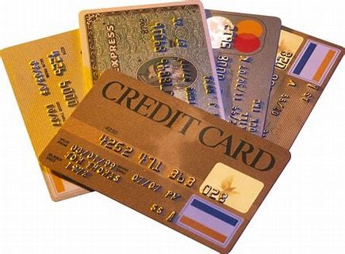
Hotel Booking analysis
3/21/2024 Annual Review

Slide 3


AGENDA
Introduction
Codes (Input)
Output
Conclusion
3/21/2024 Annual Review

Slide 4

PROBLEM STATEMENT
This project is aimed at predicting the case of customers' default payments in Taiwan. From the perspective of risk management, the result of predictive accuracy of the estimated probability of default will be more valuable than the binary result of classification - credible or not credible clients. We can use the K-S chart to evaluate which customers will default on their credit card payments.
3/21/2024 Annual Review

Slide 5

PROJECT OVERVIEW
.
Feature Engineering:
Explain the process of feature selection and creation.
Identify relevant features that may impact credit card defaults.
Discuss techniques for transforming and engineering features to improve model performance.
Model Selection and Training:
Discuss various machine learning algorithms suitable for credit card default prediction (e.g., logistic regression, decision trees, random forests, gradient boosting).
Customer demographics (age, gender, nationality).
3/21/2024 Annual Review

Slide 6

WHO ARE THE END USERS?
Every family can be used to book hotel for their trips and other family trips and business trips use credit cards for buy now and pay later. Here it can be used to pay money now and later pay them to bank.
3/21/2024 Annual Review

Slide 7

YOUR SOLUTION AND ITS VALUE PROPOSITION
Risk Management: Credit card prediction models help financial institutions assess the risk associated with lending money to individuals. By predicting the likelihood of a customer defaulting on their credit card payments, banks can make informed decisions about extending credit lines or approving credit card applications.
Fraud Detection: Credit card prediction models can also be used to detect fraudulent activities. By analyzing transaction patterns and user behavior, these models can identify suspicious transactions in real-time, helping to prevent financial losses for both the cardholder and the bank.
Customer Experience: Predictive models can improve the overall customer experience by identifying potential issues before they escalate. For example, if a customer is at risk of defaulting on their credit card payments, proactive measures can be taken, such as offering financial counseling or restructuring payment plans, to prevent default and maintain a positive relationship with the customer.
3/21/2024 Annual Review

Slide 8

THE WOW IN YOUR SOLUTION
Here it has been separated by sores for each users to gain the average of liked consumers in the population
Predictive Personalization:
Our solution goes beyond traditional analytics by offering predictive personalization. By analyzing historical booking data and customer behaviors, we predict individual preferences and tailor recommendations, offers, and experiences to each guest, creating memorable and personalized stays that exceed expectations.
Dynamic Pricing Optimization:
We revolutionize revenue management with dynamic pricing optimization. Our platform continuously analyzes market demand, competitor pricing, and customer trends in real-time to dynamically adjust room rates, maximizing revenue without compromising occupancy levels or guest satisfaction.
AI-Driven Virtual Concierge:
Experience the future of hospitality with our AI-driven virtual concierge. Seamlessly integrated into our platform, this intelligent assistant anticipates guest needs, provides personalized recommendations, and facilitates instant bookings, enhancing convenience and delivering exceptional service 24/7.
3/21/2024 Annual Review
8

Slide 9
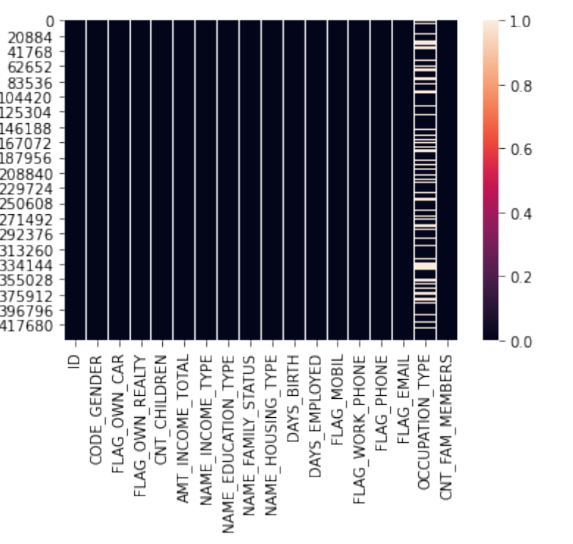
RESULTS
3/21/2024 Annual Review
9

